Slide 1
INTRODUCTION TO DATABASE
Course : ISYS6280 – Database Systems (GAT)
Year : 2017
Session 1

Slide 2
LEARNING OUTCOME
LO 1 : Describe database systems, terminology, environment, and new concept of database

Slide 3
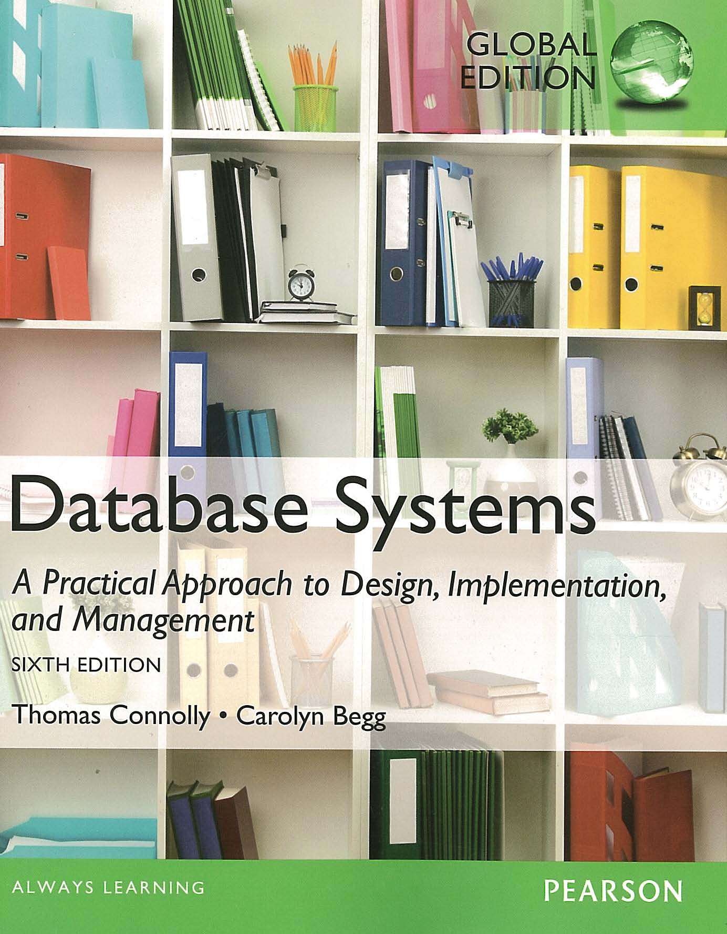
ACKNOWLEDGEMENT
These slides have been adapted from Thomas Connolly and Carolyn Begg. 2015. Database Systems: A Practical Approach To Design, Implementation, and Management. Pearson Education. USA. ISBN:978-1-292-06118-4

Slide 4
CHAPTER 1 INTRODUCTION TO DATABASE

Slide 5
LEARNING OBJECTIVES
Some common uses of database systems.
Characteristics of file-based systems.
Problems with file-based approach.
Meaning of the term database.
Meaning of the term Database Management System (DBMS).

Slide 6
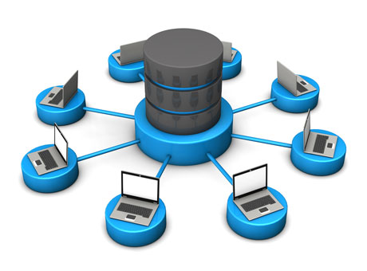
Examples of Database Applications
^{Purchases from the supermarket}
Purchases using your credit card
Booking a holiday at the travel agents
^{Using the local library}
^{Taking out insurance}
^{Renting a video}
^{Using the Internet}
^{Studying at university}
jeru.web.id

Slide 7
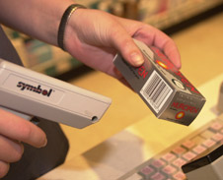
Purchases from the supermarket
The checkout assistant uses a bar code reader to scan each of your purchases → to find out the price of the item & reduce its stock
If the reorder level falls below the specific threshold → automatically place an order of that item
Check the availability of the item via customer services
www.bbc.co.uk

Slide 8
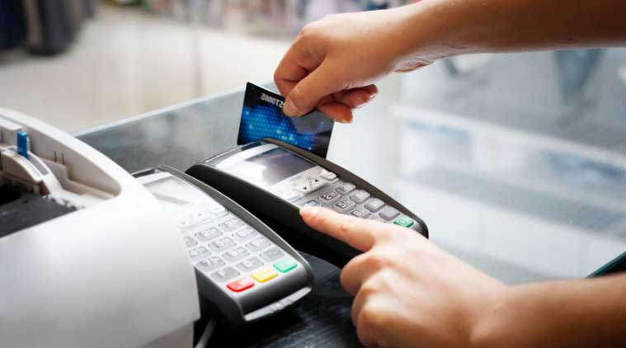
Purchases using your credit card
To check whether you have sufficient credit left, by using your credit card number to check that your recent purchase together with the sum of the purchases you have already made this month is within your credit limit. When the purchase is confirmed, the details of the purchase are recorded.
To check that the credit card is not on the list of stolen or lost cards before authorizing the purchase.
There are other application programs to send out monthly statements to each cardholder and to credit accounts when payment is received.
indianexpress.com

Slide 9

Booking a holiday at the travel agents
When you book your holiday, the database system has to make all the necessary booking arrangements → to ensure that two different agents do not book the same holiday or overbook the seats on the flight.
For example, if there is only one seat left on the flight from London to New York and two agents try to reserve the last seat at the same time, the system has to recognize this situation, allow one booking to proceed, and inform the other agent that there are now no seats available.
The travel agent may have another, usually separate, database for invoicing.
www.parenting-blog.net

Slide 10
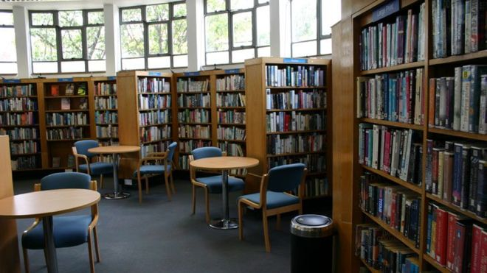
Using the local library
There will be a computerized index that allows readers to find a book based on its title, or its authors, or its subject area.
The database system handles reservations to allow a reader to reserve a book and to be informed by mail when the book is available.
The system also sends reminders to borrowers who have failed to return books by the due date.
Typically, the system will have a bar code reader, similar to that used by the supermarket described earlier, which is used to keep track of books coming in and going out of the library.
www.bbc.co.uk

Slide 11
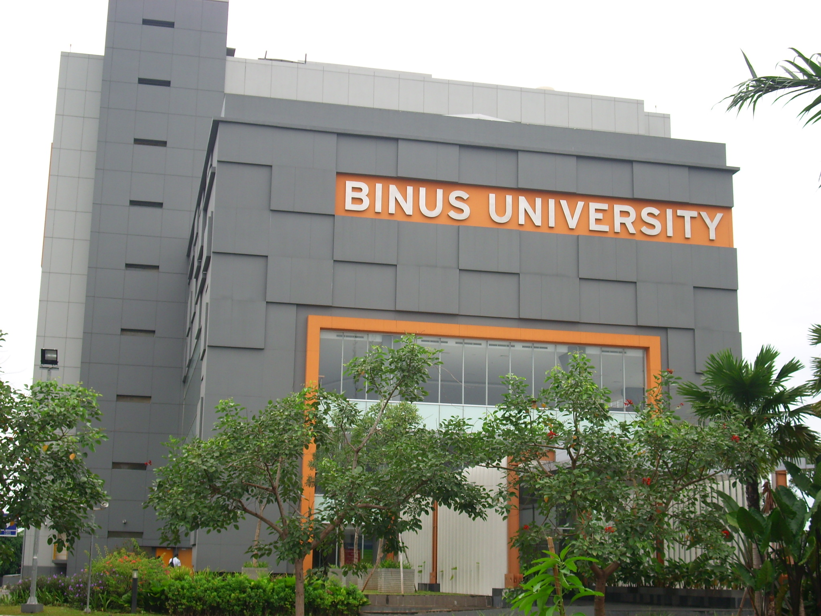
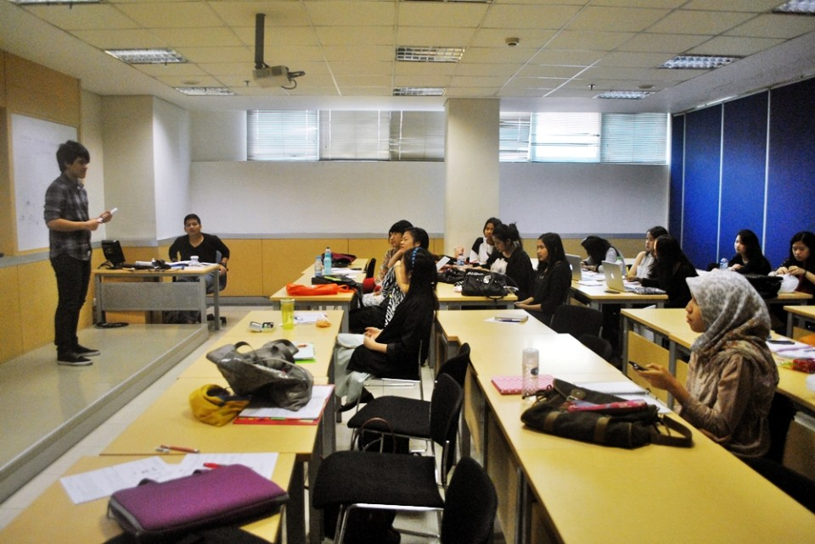
Studying at university
There will be a database system containing information about yourself, the course you are enrolled in, details about your grant, the modules you have taken in previous years or are taking this year, and details of all your examination results.
There may also be a database containing details relating to the next year’s admissions.
A database containing details of the staff who work at the university, giving personal details and salary-related details for the payroll office.

Slide 12
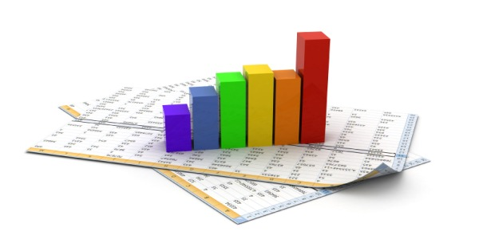
File-Based Systems
Collection of application programs that perform services for the end users (e.g. reports).
Each program defines and manages its own data.
ictlabs-summer-school.sics.se

Slide 13
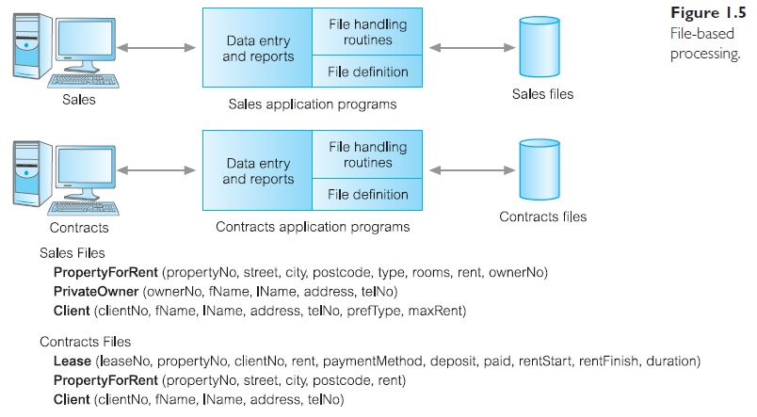
File-Based Processing

Slide 14
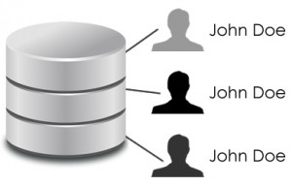
Limitations of File-Based Approach
Separation and isolation of data
Each program maintains its own set of data.
Users of one program may be unaware of potentially useful data held by other programs.
Duplication of data
Same data is held by different programs.
Wasted space and potentially different values and/or different formats for the same item.
www.417solutions.com

Slide 15
Limitations of File-Based Approach
Data dependence
File structure is defined in the program code.
Incompatible file formats
Programs are written in different languages, and so cannot easily access each other’s files.
Fixed Queries/Proliferation of application programs
Programs are written to satisfy particular functions.
Any new requirement needs a new program.

Slide 16

Database Approach
Arose because:
Definition of data was embedded in application programs, rather than being stored separately and independently.
No control over access and manipulation of data beyond that imposed by application programs.
Result:
the database and Database Management System (DBMS).
www.smppgrisatubdl.com

Slide 17
Database
Shared collection of logically related data (and a description of this data), designed to meet the information needs of an organization.
System catalog (metadata) provides description of data to enable program–data independence.
Logically related data comprises entities, attributes, and relationships of an organization’s information.

Slide 18
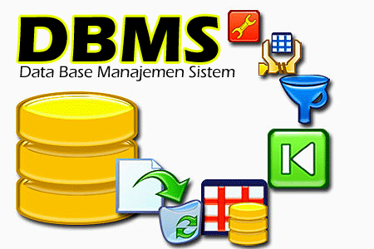
Database Management System (DBMS)
A software system that enables users to define, create, maintain, and control access to the database.
(Database) application program: a computer program that interacts with database by issuing an appropriate request (SQL statement) to the DBMS.
www.purwadhikapress.com

Slide 19
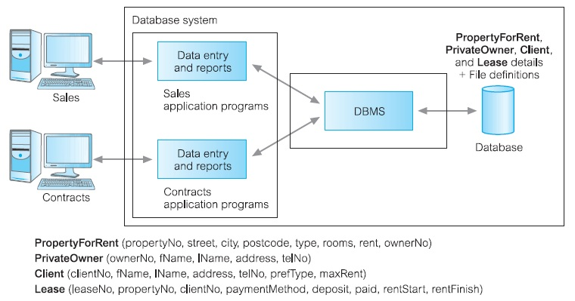
Database Management System (DBMS)

Slide 20
Database Approach
Data definition language (DDL).
Permits specification of data types, structures and any data constraints.
All specifications are stored in the database.
Example: CREATE, ALTER, DROP
To add, modify, delete Database Object (Table, View, User, etc)
Data manipulation language (DML).
General enquiry facility (query language) of the data.
Example: INSERT INTO...VALUES,
UPDATE..SET... <WHERE>, DELETE <WHERE>, SELECT...FROM...<WHERE>
To add, modify, delete, retrieve record/tuple/row

Slide 21
Database Approach
Controlled access to database may include:
a security system
an integrity system
a concurrency control system
a recovery control system
a user-accessible catalog.

Slide 22
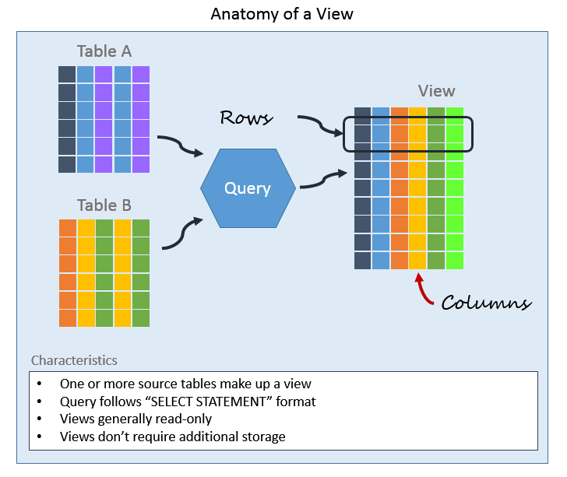
Views
Allows each user to have his or her own view of the database.
A view is essentially some subset of the database.
www.essentialsql.com

Slide 23

Benefits of View
^{Reduce complexity}
^{Provide a level of security}
Provide a mechanism to customize the appearance of the database
Present a consistent, unchanging picture of the structure of the database, even if the underlying database is changed
www.bowelcanceraustralia.org

Slide 24
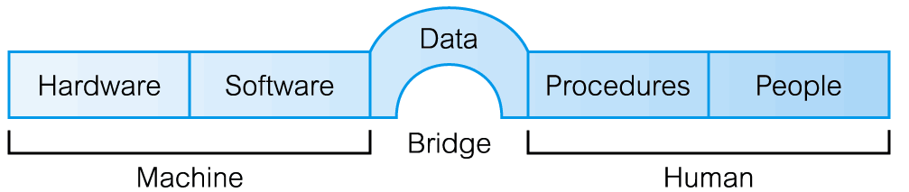
Components of DBMS Environment
Hardware
Can range from a PC to a network of computers.
Software
DBMS, operating system, network software (if necessary) and also the application programs.
Data
Used by the organization and a description of this data called the schema.

Slide 25

Components of DBMS Environment
Procedures
Instructions and rules that should be applied to the design and use of the database and DBMS.
People
pelajar-sejati.blogspot.com

Slide 26
Roles in the Database Environment
Data Administrator (DA)
is responsible for the management of the data resource including database planning, development and maintenance of standards, policies and procedures, and conceptual/logical database design.
Database Administrator (DBA)
is responsible for the physical realization of the database, including physical database design and implementation, security and integrity control, maintenance of the operational system, and ensuring satisfactory performance of the applications for users (technically oriented).

Slide 27
Roles in the Database Environment
Database Designers (Logical and Physical)
The logical database designer is concerned with identifying the data (that is, the entities and attributes), the relationships between the data, and the constraints on the data that is to be stored in the database (must have a thorough and complete understanding of the organization’s data and any constraints/business rules on this data).
The physical database designer decides how the logical database design is to be physically realized. This involves: (a) mapping the logical database design into a set of tables and integrity constraints; (b) selecting specific storage structures and access methods for the data to achieve good performance; (c) designing any security measures required on the data.

Slide 28
Roles in the Database Environment
Application Developers/Programmers
Implement the application programs that provide the required functionality for the end-users.
End Users (naive and sophisticated)
Naïve users are typically unaware of the DBMS. They access the database through specially written application programs that attempt to make the operations as simple as possible. For example, the checkout assistant at the local supermarket.
The sophisticated end-user is familiar with the structure of the database and the facilities offered by the DBMS → may use a high-level query language such as SQL to perform the required operations or even write application programs for their own use.

Slide 29
History of Database Systems
First-generation
Hierarchical and Network
Second generation
Relational
Third generation
Object-Relational
Object-Oriented

Slide 30

Advantages of DBMSs
^{Control of data redundancy}
^{Data consistency}
More information from the same amount of data
^{Sharing of data}
^{Improved data integrity}
^{Improved security}
^{Enforcement of standards}
^{Economy of scale}
www.jpfarley.com

Slide 31
Advantages of DBMSs
Balance conflicting requirements
Improved data accessibility and responsiveness
^{Increased productivity}
Improved maintenance through data independence
^{Increased concurrency}
Improved backup and recovery services
www.jpfarley.com

Slide 32

Disadvantages of DBMSs
^{Complexity}
^{Size}
^{Cost of DBMS}
^{Additional hardware costs}
^{Cost of conversion}
^{Performance}
^{Higher impact of a failure}
blog.commlabindia.com

Slide 33

www.healthytravelblog.com

